Slide 1
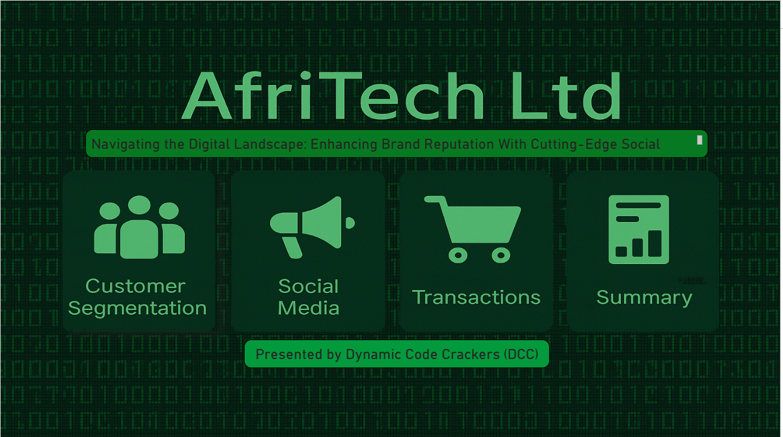

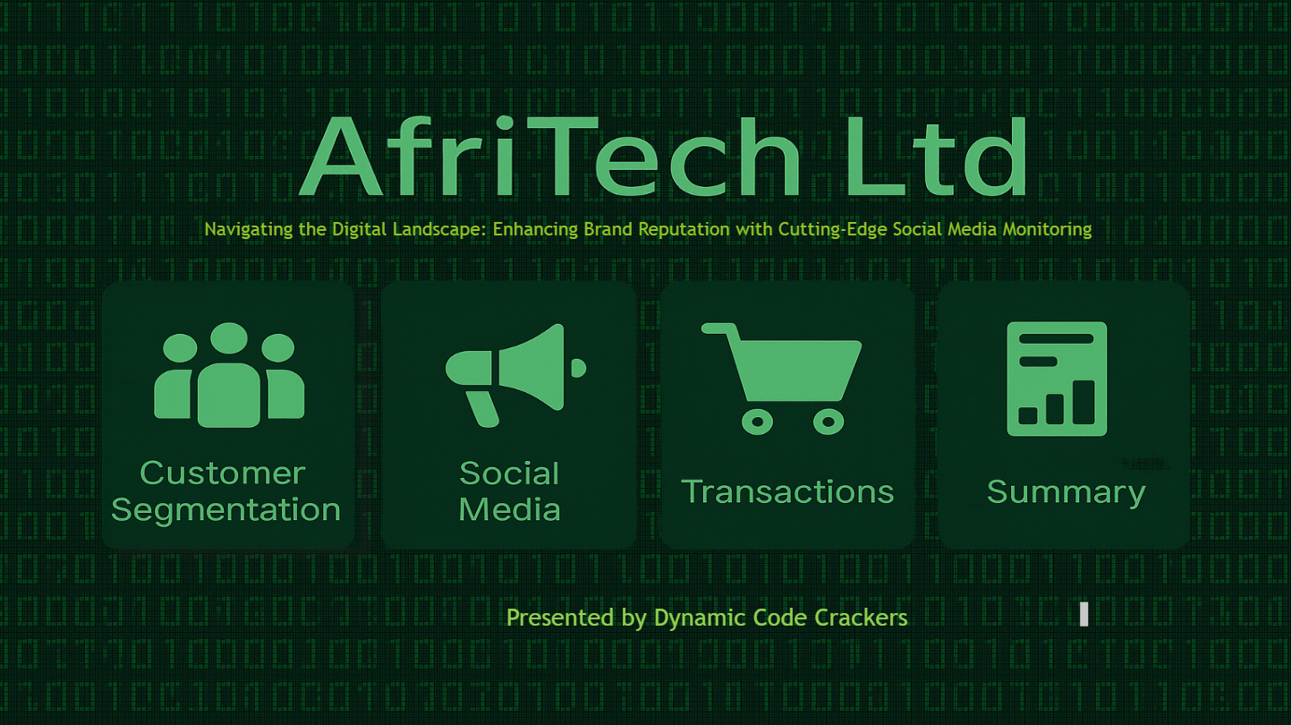
Presented by Dynamic Code Crackers

Slide 2

Table Of Content Introduction Specific Problem Aim of the project Three key sections Customer Segmentation Insight (CSI) Key Insights Social Media Insight (SM) Key Insight Transactions Insight (T) Key Insight Summary of Recommendations. Thanks to DCC.

Slide 3
INTRODUCTION
This data presentation is for AfriTech Electronics Ltd, a U.S.-based company. AfriTech is a leading name in the global consumer electronics industry, known for its innovation in smartphones, tablets, and wearable technology.
AfriTech has experienced steady growth, now employing 200 staff members. In 2022, the company reported a strong annual revenue of $2 million.
Despite the above achievements, the company is not immune to problems. In recent years, AfriTech has been facing the following problems:

Slide 4
Specific Problems:
1. Customer Complaints: Complaints related to product defects, delays in customer support response, and billing issues have been rising, leading to a drop in customer satisfaction.
2. Product Recalls: Recent product recalls have received significant media attention, causing panic among customers and stakeholders.
3. Negative Social Media Buzz: The above factors have led to the company experiencing a surge in negative social media conversations about its products and customer service. These conversations are damaging its brand image.
4. Competitive Pressure: Rivals are gaining market share by exploiting Afritech’s reputation challenges.

Slide 5

Aim of the Project
Brand reputation is vital in this industry, and social media heavily shapes public perception. This project aims to address that influence by the following actions:
Customer Issue Resolution: Identify and prioritize customer complaints and issues for swift resolution. This will ultimately increase Afritech’s market control
Crises Detection: Implement early warning systems to detect potential crises and take proactive measures. This will also increase Afritech’s market control
Monitor Social Media Conversations: Continuously monitor social media platforms for mentions of the company and its products.
Sentiment Analysis: Analyze sentiment in social media conversations to identify positive and negative trends and how they reflect on transactions.

Slide 6
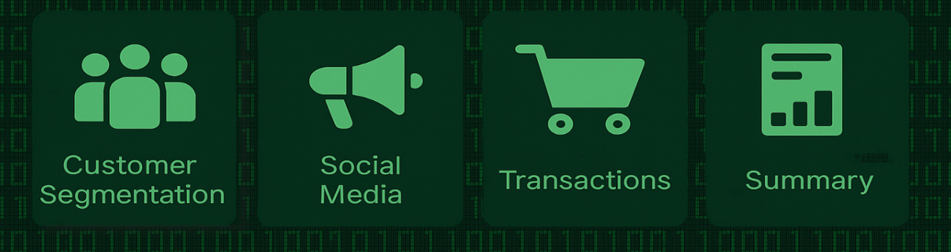
Three key sections: To ensure a thorough analysis of the problems and possible solutions, we have taken steps to analyse the three key areas:

Slide 7

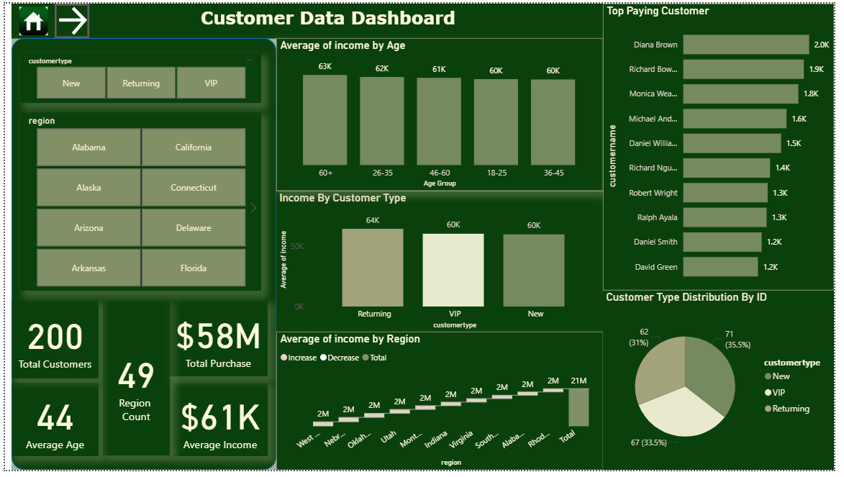
Customer segmentation (CS)

Slide 8
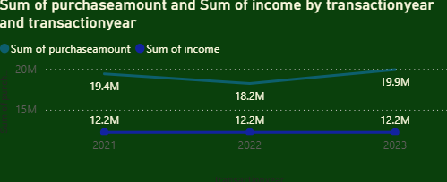
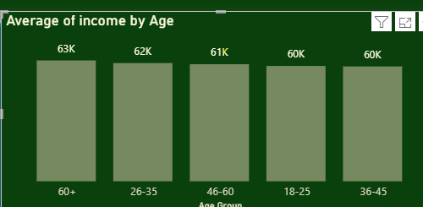
CS Key Insight
Key Insights:
Average income has stayed the same over the period and across age disposition:
Purchase amount fluctuated over the three-year period, but income stayed relatively constant:

Slide 9
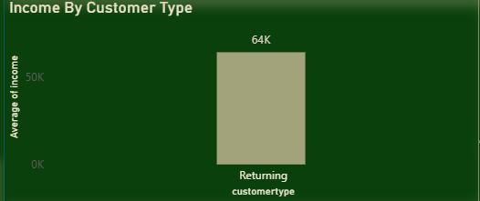
CS Key Insight
Key Insights:
Average income has stayed the same over the period and across age disposition:
Purchase amount fluctuated over the three-year period, but income stayed relatively constant:
Returning customers have on average a higher income:

Slide 10
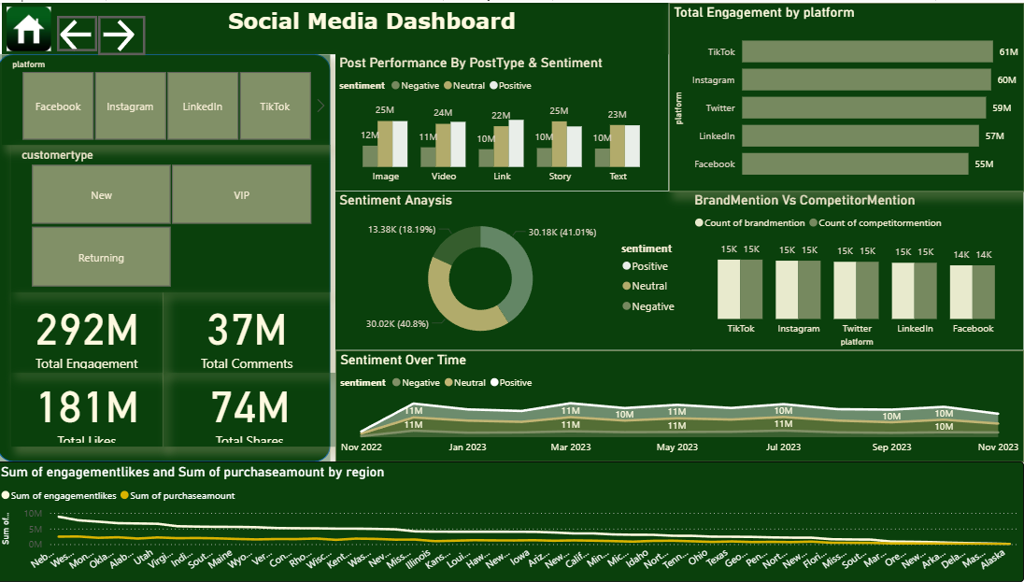
Social media (SM)

Slide 11
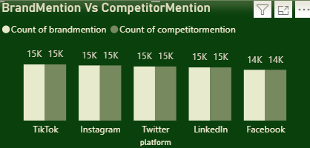
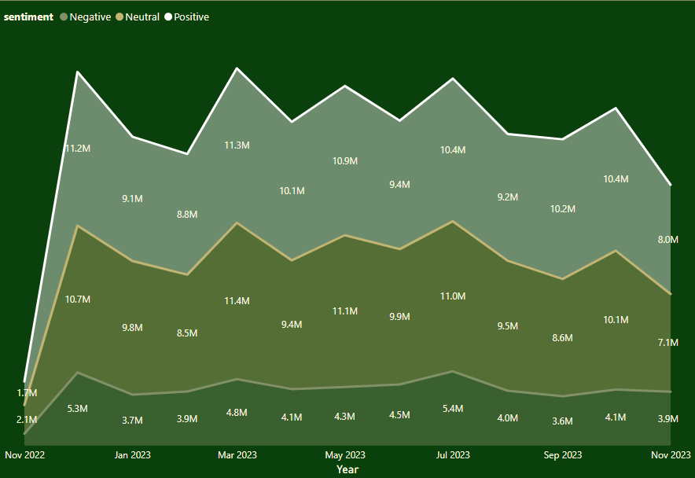
SM Key Insights
Across all social platform, the brand product is mentioned as often as our competitors:
Over the last three years, negative sentiment has been over 4million:

Slide 12
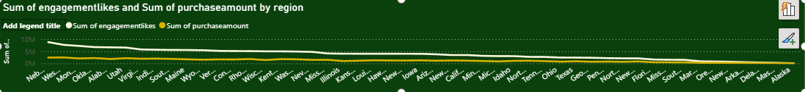
There seems to be a corelation between the sum of engagement likes and total purchases:

Slide 13
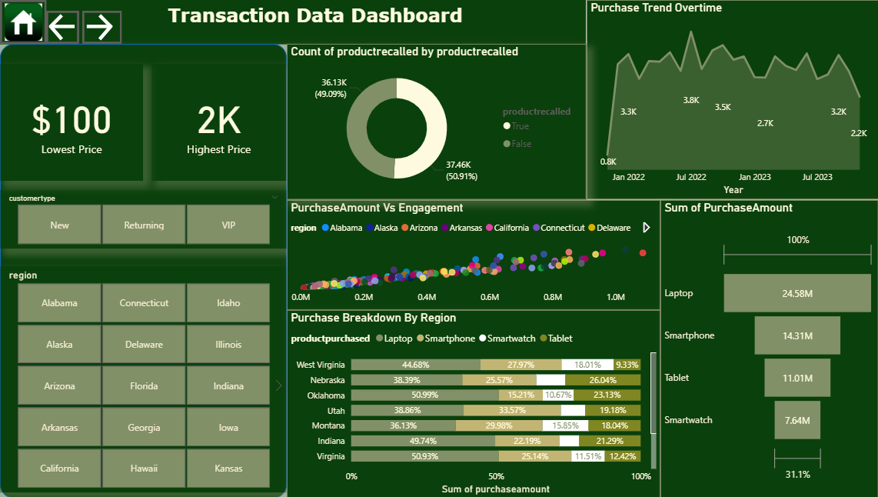
Transaction (T)

Slide 14
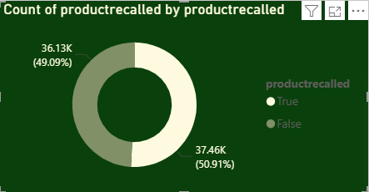
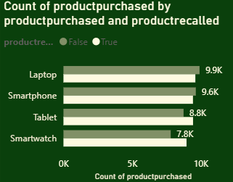
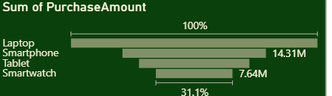
T Key Insights
Key Insights:
Over the past Three years, 50% of products sold were recalled:
Laptops had the highest number of sales and recalls followed by smartphones:

Slide 15
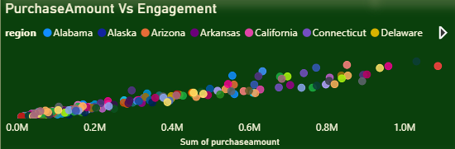
T Key Insights
Key Insights:
There is a Direct corelation between purchase amounts and online engagements:

Slide 16
RECOMMENDATION SUMMARY
Customer Segmentation
Returning customer should get discounts for retention
Set-up more customer Forums
Transaction Data
Product recalls;
Reassess Quality review and Quality control Processes prioritizing laptops and smartphones.
Take responsibilities for the recalls by Incentivizing affected customer
Social Media
Automated replies to negative comments using AI
Amplify positive comments with sponsored content or engagement boosts
Given the direct correlation between likes and purchase amount across all regions, we should incentivize who say they like our product to increase sales

